Slide 1

Module 0
Introduction to R
Notes:
Guidelines
Use section headers to chunk content in your presentation.
Use the same style of section header throughout your presentation.
Keep your title to no more than 2 lines.

Slide 2

Introduction to R
Notes:
Guidelines
Use a title slide at the beginning of your presentation. There are 9 variations of title slides to choose from.
If you will have a series of slideshows, we recommend using the same style of title slide for each presentation.
Keep your title to no more than 2 lines.
Do not change the font style or font size of the title or subtitle.

Slide 3
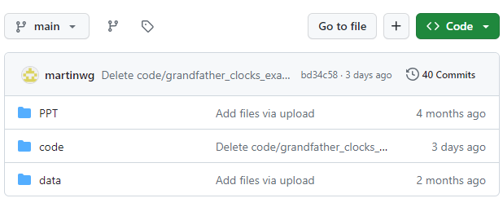
Github Page
https://github.com/martinwg/ISA291

Slide 4

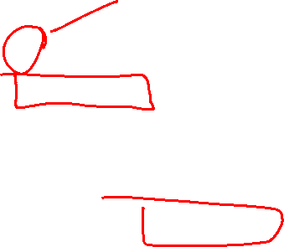
Introduction to R
R is the programming language.
R Studio is an interface through which you can code R
Visual Studio
Atom
Sublime Text
Jupyter Notebooks in Google Colab
Jupyter Notebooks in Kaggle

Slide 5
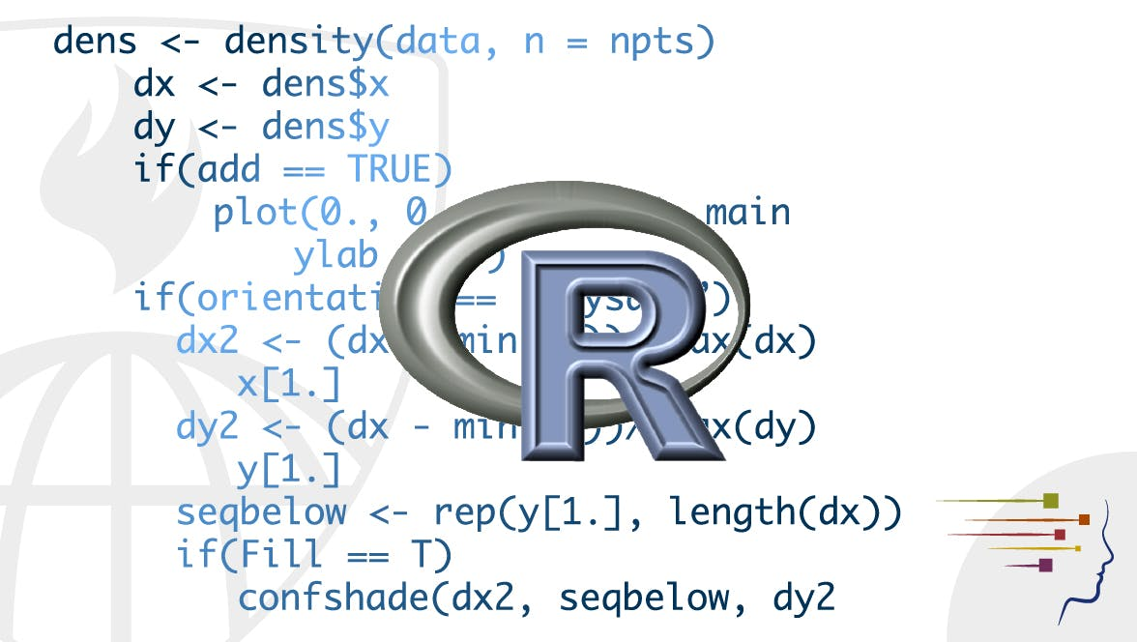
Why R?
It is free (open-source)
It is widely used
It is powerful
Widely used in industry (analytics and data science)
It is evolving

Slide 6
Installing R and RStudio
Notes:
Guidelines
Use a title slide at the beginning of your presentation. There are 9 variations of title slides to choose from.
If you will have a series of slideshows, we recommend using the same style of title slide for each presentation.
Keep your title to no more than 2 lines.
Do not change the font style or font size of the title or subtitle.

Slide 7
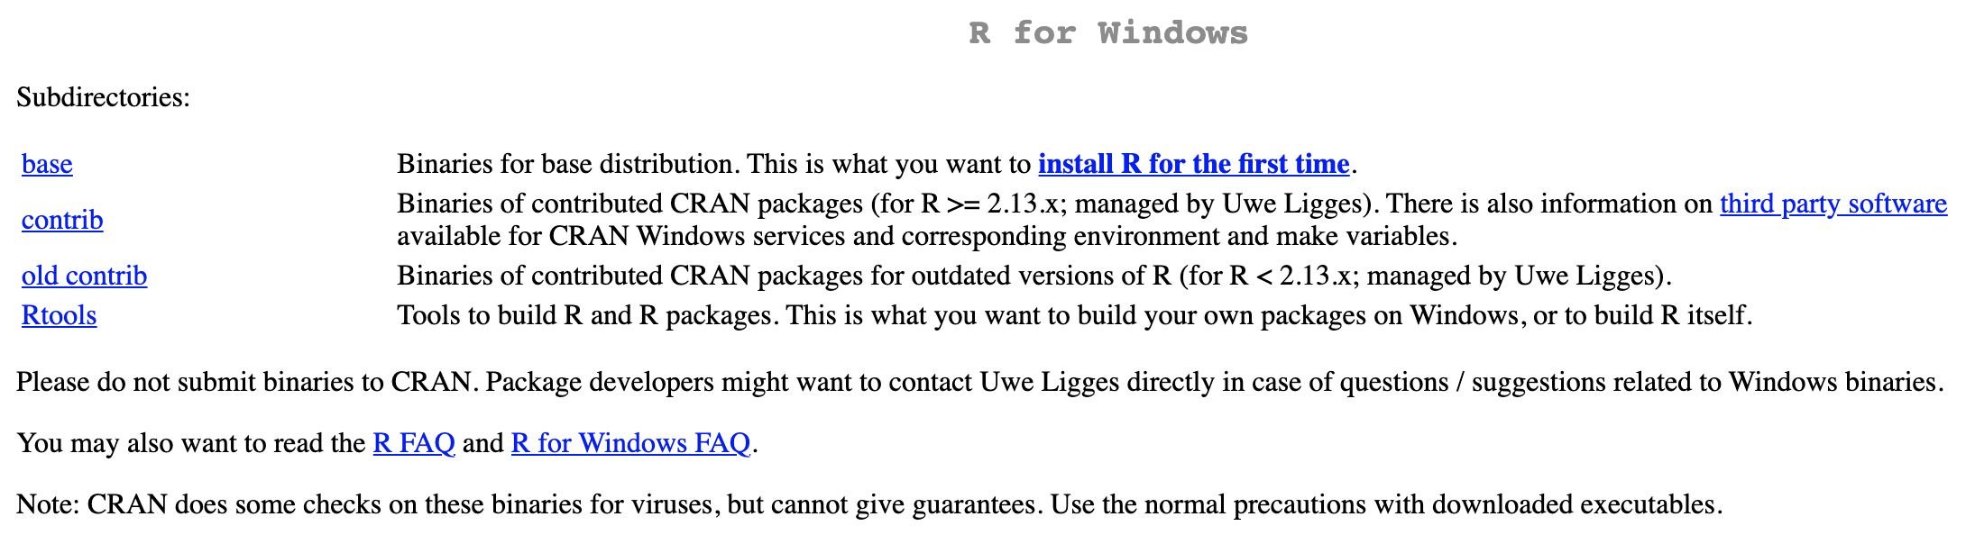

How to install R in your computer
Install the R programming language first
Go to https://www.r-project.org/ - CRAN
Use any URL. The 0-Cloud would do best if unsure.
Use link to your OS.
Select base
Install the RStudio IDE
Go to https://www.rstudio.com/
Select the free version
Use link to your OS

Slide 8
RStudio Basics
Notes:
Guidelines
Use a title slide at the beginning of your presentation. There are 9 variations of title slides to choose from.
If you will have a series of slideshows, we recommend using the same style of title slide for each presentation.
Keep your title to no more than 2 lines.
Do not change the font style or font size of the title or subtitle.

Slide 9
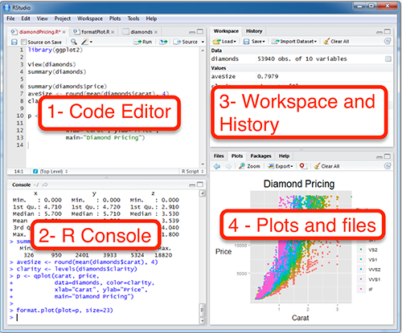
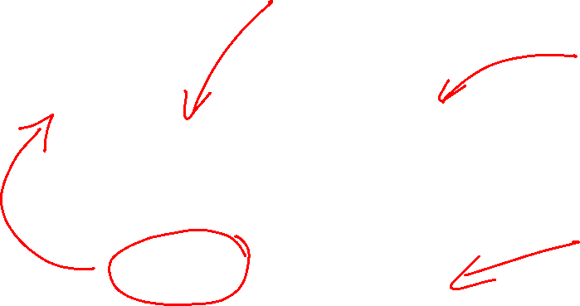
Working with RStudio
The RStudio Environment (Four Panels)

Slide 10
R Scripts – Code Editor
Create scripts in the code editor to save and reuse code
Click on File > New File > R Script

Slide 11
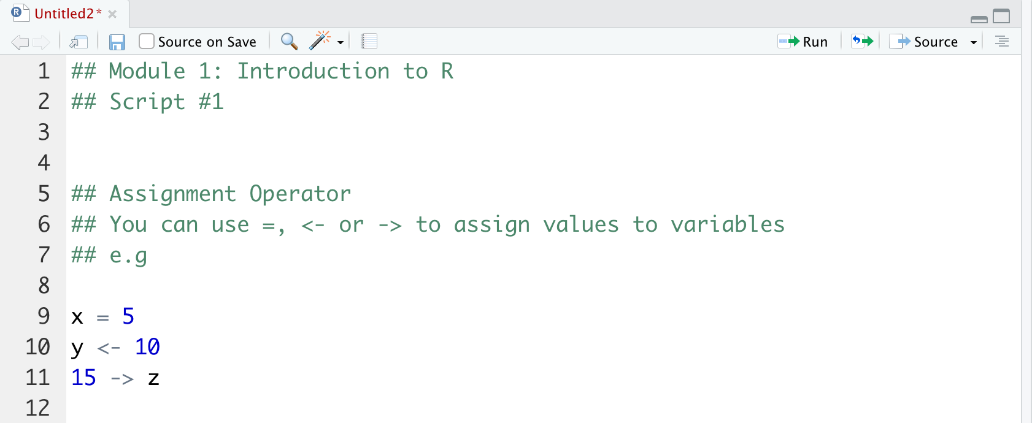
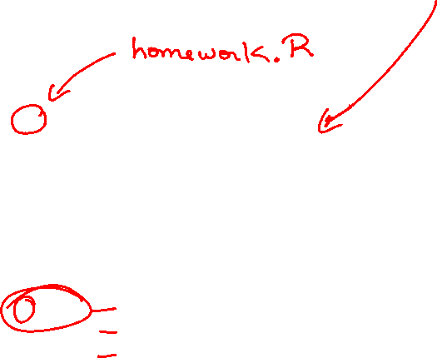
R Scripts – Code Editor
Create the script below
Save the script

Slide 12

Run Code – R Console
The code needs to be run in the R console
The console is where R gets and outputs results from commands

Slide 13
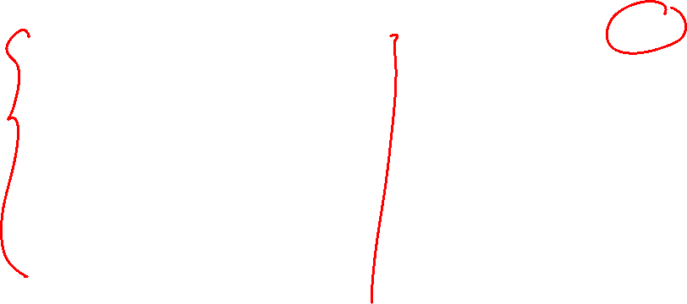
Run Code – R Console
You can run scripts by highlighting code and clicking run
You can highlight code
And click Run

Slide 14
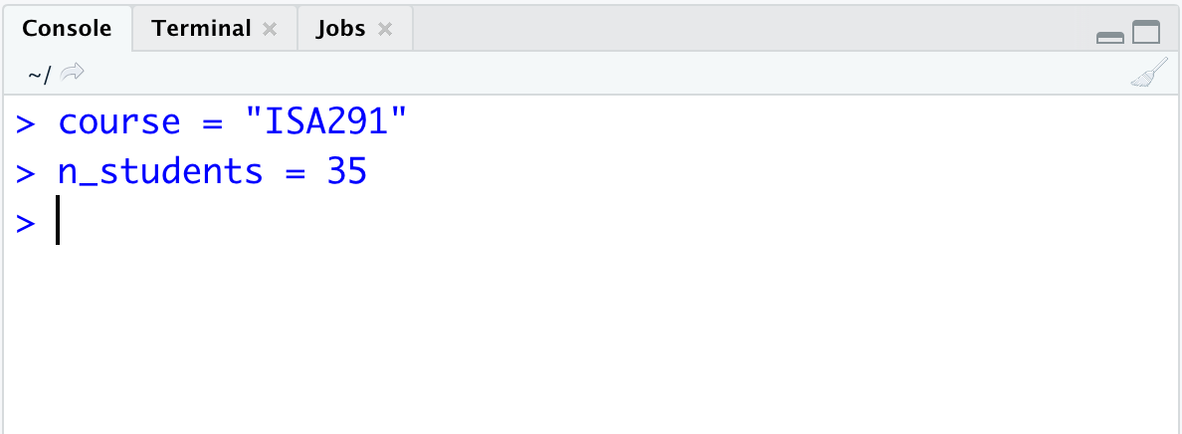

Run Code – R Console
You can also run lines directly on the console (not saved)

Slide 15
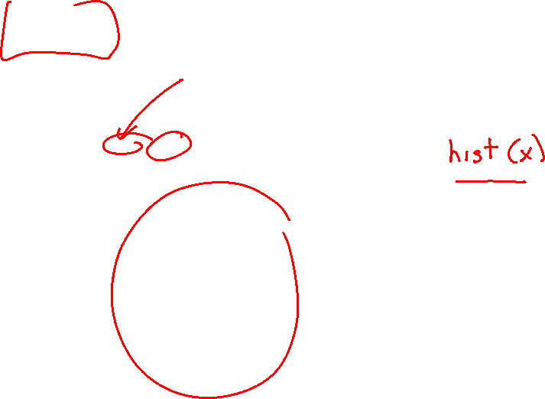
Plots – Files, Plots, Packages, Help
You can view, save plots from this panel

Slide 16
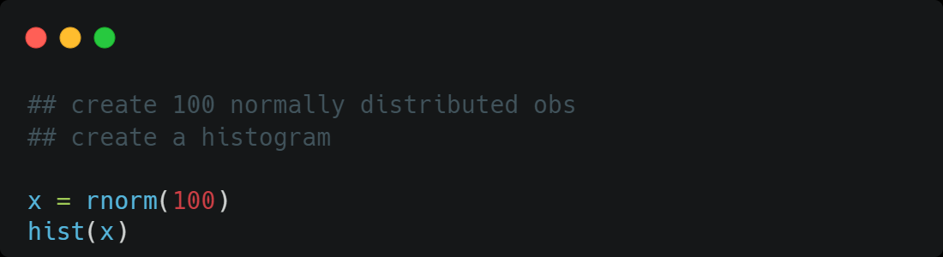
Plots – Files, Plots, Packages, Help
Run the code below:

Slide 17


In which panel(s) do you run and execute code?
ⓘ Start presenting to display the poll results on this slide.

Slide 18
Where can I get help and view plots?
ⓘ Start presenting to display the poll results on this slide.

Slide 19
Where can I get help and view plots?
ⓘ Start presenting to display the poll results on this slide.

Slide 20




Using R in the Cloud
You can use R in a remote instance of Google Colab or Kaggle
For Google Colab
Go to https://colab.research.google.com/
Sign in to you Google Account
Click Runtime – Change Runtime Type – Select R

Slide 21
Introduction to R Programming Syntax
Notes:
Guidelines
Use a title slide at the beginning of your presentation. There are 9 variations of title slides to choose from.
If you will have a series of slideshows, we recommend using the same style of title slide for each presentation.
Keep your title to no more than 2 lines.
Do not change the font style or font size of the title or subtitle.

Slide 22
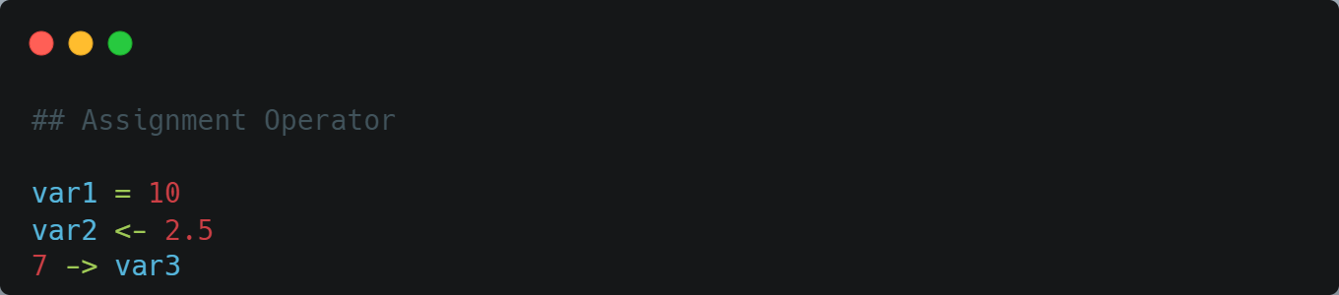
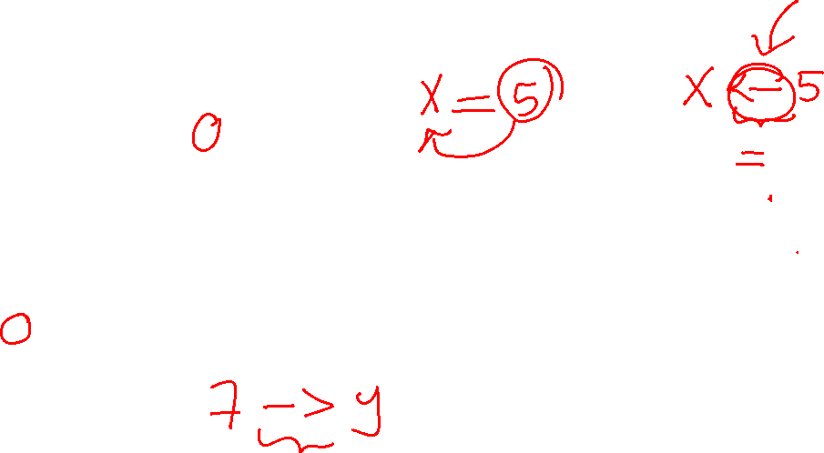
Assignment Operator
We can use =, <-, or ->

Slide 23
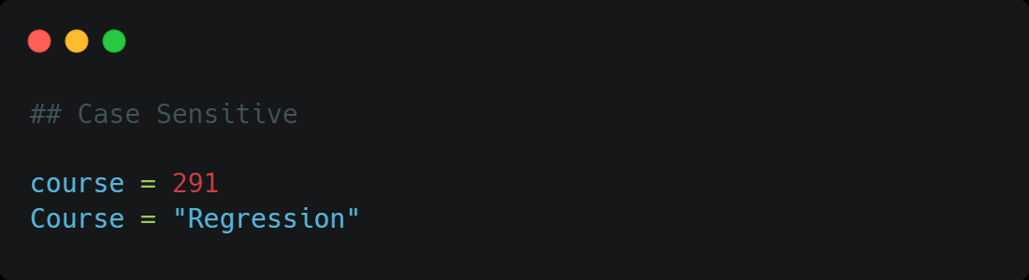

Case Sensitivity
R is case sensitive

Slide 24
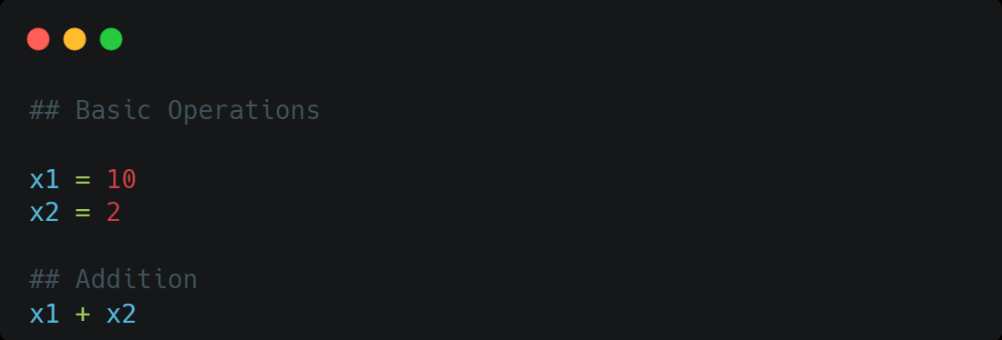
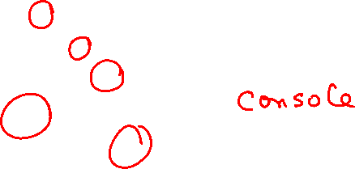
Basic Operations in R
Addition: +
Subtraction: –
Multiplication: *
Division: /
Exponentiation: ^

Slide 25
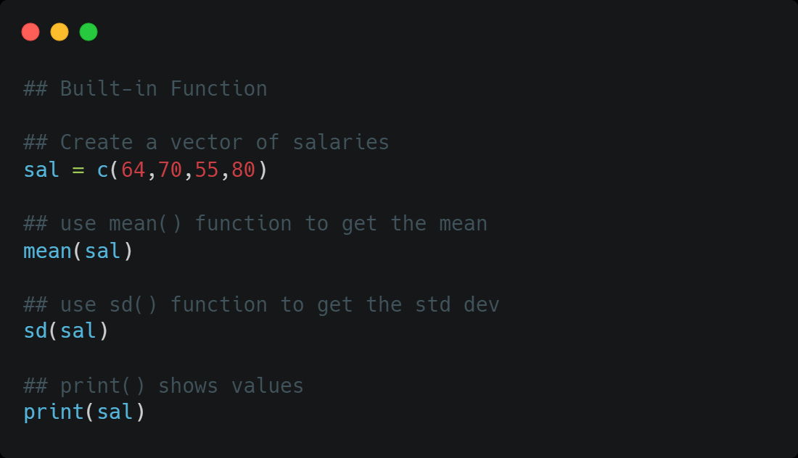
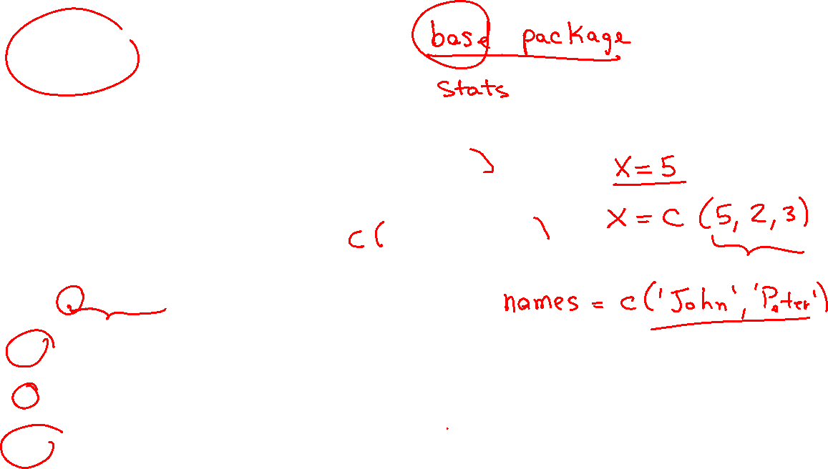
Built-in Functions
Function is a block of code used to perform an action
Built-in Functions are always available to user

Slide 26

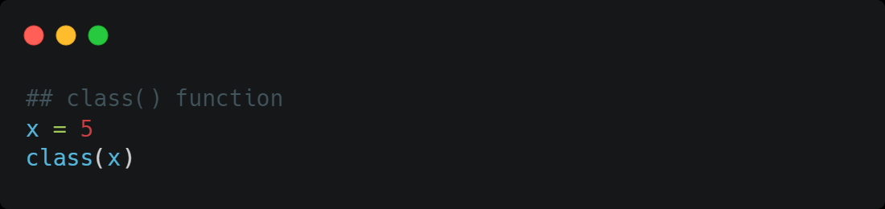
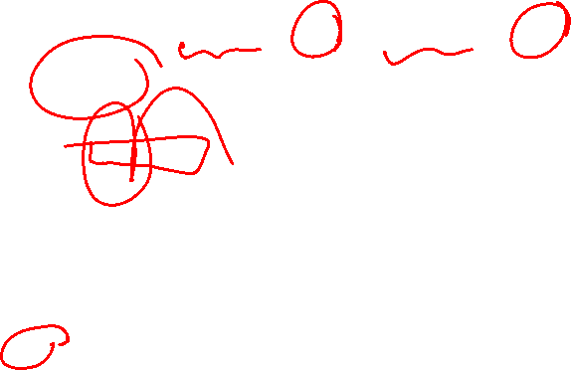
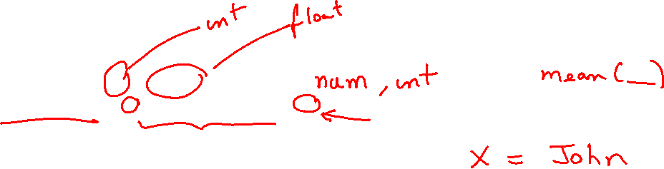
Data Types
Numeric: 2, 3.5
Character: “Regression”
Logical: TRUE, T, FALSE, F
Matrix:

Slide 27
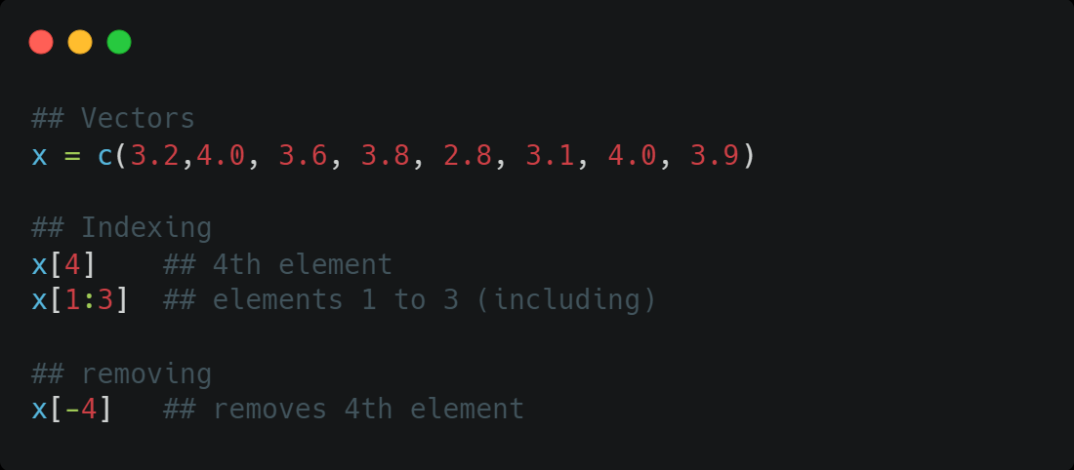
Data Structures - Vectors
Lists (vectors): x = c(3.2, 4.0, 3.6)
Indexing: x[1] # shows first element
Removing: x[-3] # removes element 3

Slide 28
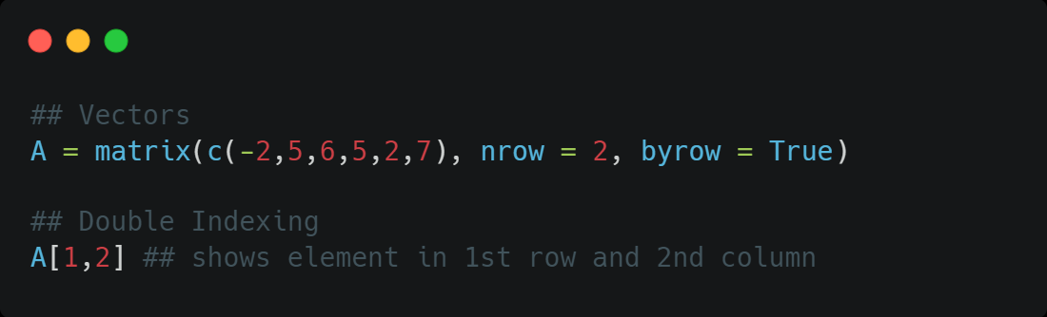
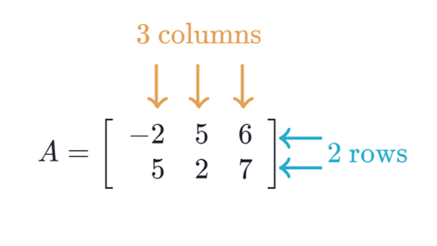
Data Structures – Matrices
Data structure with columns and rows

Slide 29
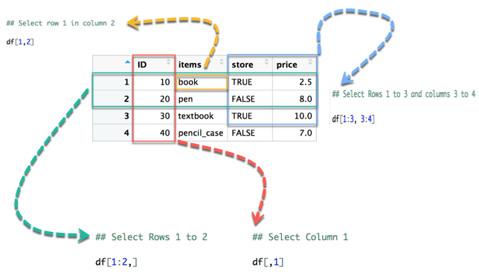
Data Structures – Data Frames
Similar to matrices but can contain different data types

Slide 30
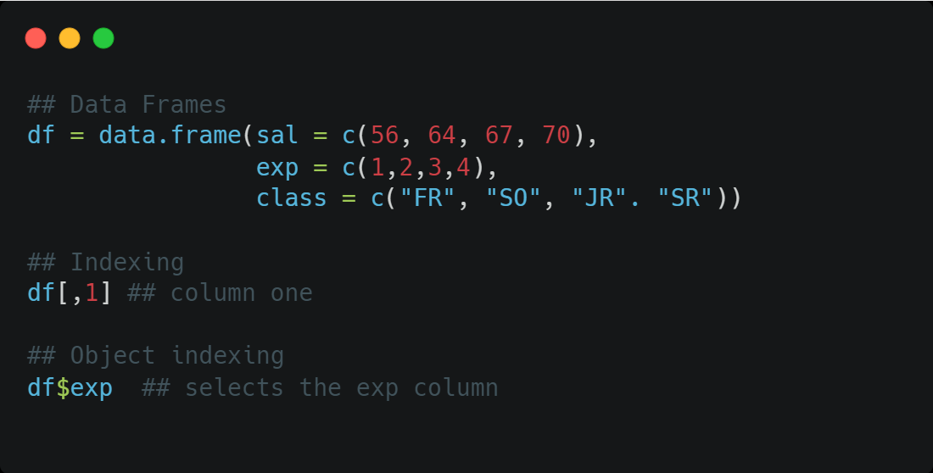
Data Structures – Data Frames
Similar to matrices but can contain different data types

Slide 31
The following statements in R are the same: x = 5 x <- 5
ⓘ Start presenting to display the poll results on this slide.

Slide 32
R is case-sensitive. In other words, the statements y = 10 Y = 10 create two different objects
ⓘ Start presenting to display the poll results on this slide.

Slide 33
The variable x as described below is of type x = 2.5
ⓘ Start presenting to display the poll results on this slide.

Slide 34
Summary
Hopefully, you have successfully installed R and R Studio.
From this set of notes you should
Be able to identify and define:
The R console
The R Global Environment
Know how to comment text
Create and save a R script.
Assign a value to an object using <- or =.
Run R code from a script.
Run code in the console
Create basic operations in R
Practice with built-in functions
Understand basic data types (numeric, character, logical)
Understand basic data structures (lists, matrices, data frames)

Slide 35
Happy Learning!
Notes:
Guidelines
Use section headers to chunk content in your presentation.
Use the same style of section header throughout your presentation.
Keep your title to no more than 2 lines.

